Slide 1

Advance Data Challenge Project. Presented By: 1)Partow Khushkanab Moradi 2) Ankitha Kakade
Child Mind Institute - Detect Sleep States

Slide 2

Contents:
Overview
Data Understanding
Difficulty faced
What is done so far!

Slide 3
Overview/ Description
AIM: To detect the occurrence of these two events in the accelerometer series.
The dataset comprises about 500 multi-day recordings of wrist-worn accelerometer data annotated with two event types: onset, the beginning of sleep, and wakeup, the end of sleep.

Slide 4
Data Understanding
Files and Field Descriptions:
train_series.parquet - Series to be used as training data. Each series is a continuous recording of accelerometer data for a single subject spanning many days.
test_series.parquet - Series to be used as the test data, containing the same fields as above. You will predict event occurrences for series in this file.
train_events.csv - Sleep logs for series in the training set recording onset and wake events
sample_submission.csv - A sample submission file in the correct format. See the Evaluation page for more details.

Slide 5
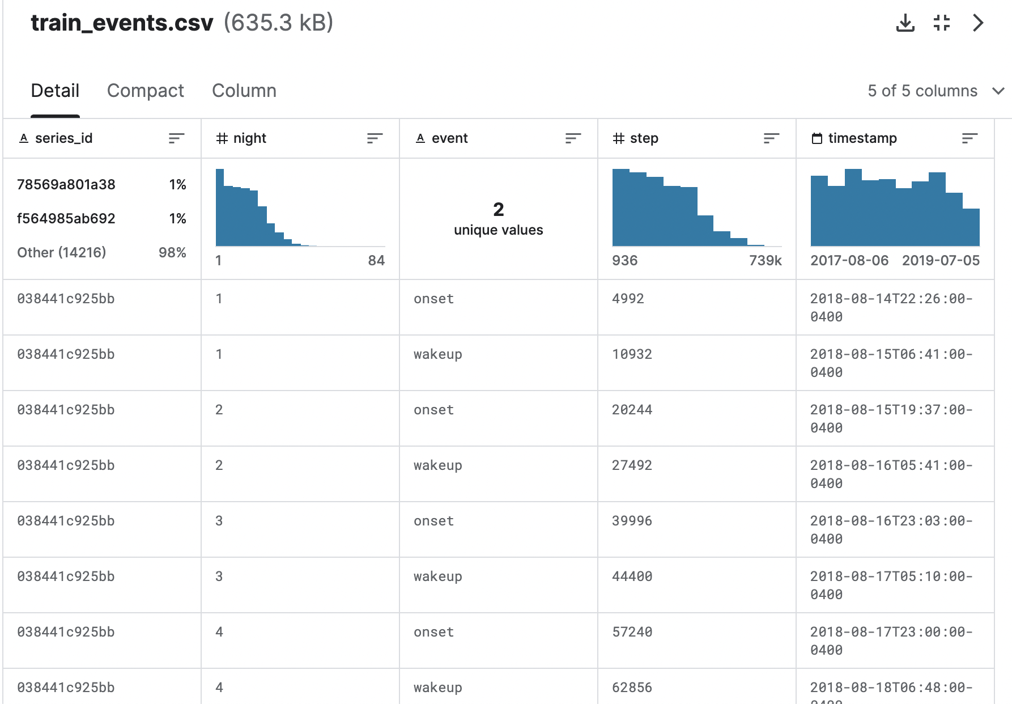
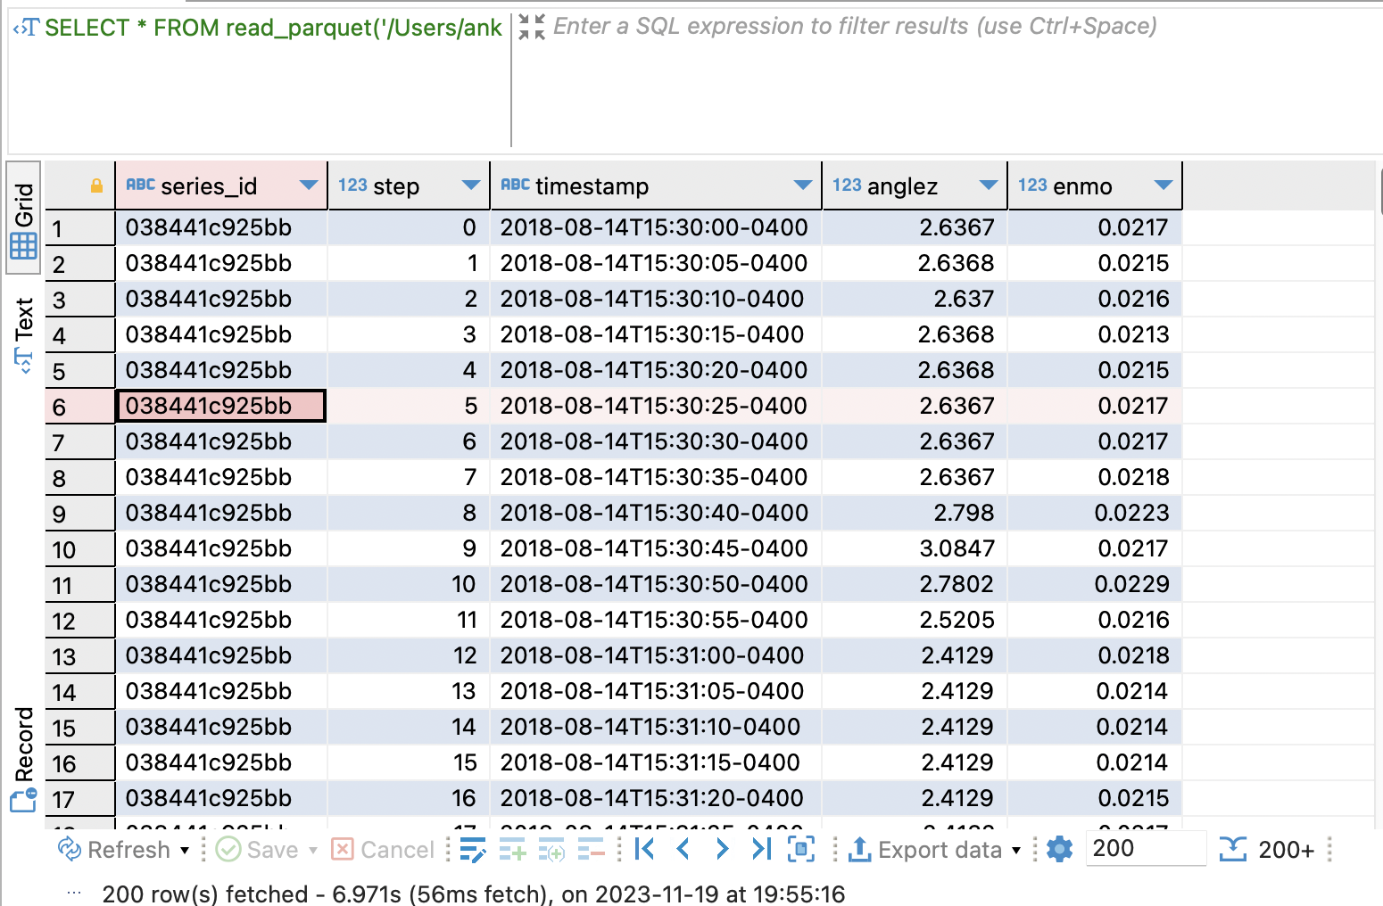

Slide 6
Data Cleaning:
We have cleaned the data by changing the String format to Date.

Slide 7
Data description:

Slide 8
Null values

Slide 9
Correlation matrix

Slide 10
Data Cleaning and Difficulty Faced:
The files we downloaded from Kaggle was in the format of ".parquet", we could access the file in DBeaver.
Changes were made for the attributes from String to Timestamp (Date).

